Slide 1
Java程序设计
第15章 图形

Slide 2
学习目标
理解Java的坐标系
使用Graphics类中的方法画图
使用paintComponent方法在JComponent的子类（例如面板、按钮）中绘制图形
使用paint方法在顶级容器（例如JFrame）中绘制图形

Slide 3
§15.2 Java的图形坐标系
(0,0)
x
y
显示器
win.getX()
win.getY()
(x,y)
(0,0)
窗口
(0,0)
面板
p.getX()
p.getY()
(0,0)
x
(0,0)
按钮
传统坐标系
y
Java坐标系
(x,y)
组件内部以组件左上角为坐标原点。
组件外部以组件所在容器的左上角为坐标原点。
父级坐标

Slide 4
坐标演示程序
import java.awt.*;
import javax.swing.*;
public class G extends JFrame{
JButton bt=new JButton("提交");
public G(String s){
setTitle(s);
setSize(400,300);
setLocation(200,100);//设置窗口左上角位置（相对于屏幕）
bt.setBounds(200,100,80,30);//设置按钮位置和宽、高(相对于ContentPane)
setLayout(null);
add(bt);
setDefaultCloseOperation(EXIT_ON_CLOSE);
setVisible(true);
}
public static void main(String []s){
G win=new G("坐标演示窗口");
System.out.println("窗口的位置"+win.getLocation());
System.out.println("窗口在屏幕上的位置"+win.getLocationOnScreen()+'\n');
System.out.println("内容面板在窗口里的位置"+win.getContentPane().getLocation());
System.out.println("内容面板在屏幕上的位置"+win.getContentPane().getLocationOnScreen()+'\n');
System.out.println("按钮在内容面板上的位置"+win.bt.getLocation());
System.out.println("按钮在屏幕上的位置"+win.bt.getLocationOnScreen());
}
}

Slide 5
§ 15.3 java.awt.Graphics类
java.lang.Object
java.awt.Graphics 抽象类
java.awt.Graphics2D 抽象类
可以利用Graphics类中的方法绘制线段、矩形、椭圆、圆弧、多边形。
  getFont/setFont, getColor/setColor, getStroke/setStroke
默认颜色是组件的前景色，默认字体是组件的字体，默认线宽1
  绘制(空心)：draw3DRect, drawArc, drawImage, drawLine, drawOval, drawPolygon, drawPolyline, drawRect, drawRoundRect, drawString
  填充(实心)：fill3DRect, fillArc, fillOval, fillPolygon, fillRect, fillRoundRect

Slide 6
JVM自动为每个组件创建一个Graphics对象
paint和paintComponent
调用从Component类继承来的getGraphics()方法可以获取Graphics对象。
在窗口里绘图，覆盖继承自Component的public void paint方法
在面板等组件里绘图，覆盖继承自JComponent的protected void paintComponent方法。当然也可用继承自Container的paint方法。paint会委托给paintComponent、paintBorder 和 paintChildren。
这两个方法在组件第一次显示或需要重绘时，由Java虚拟机自动调用。
  protected void paintComponent(Graphics g)
程序员不能主动调用这2个方法，只能通过repaint调用。
通常在JPanel中进行绘图。
setVisible(true)
最大化、还原
repaint()

Slide 7
验证paint的执行时机
第一次显示
最大化
还原
repaint()
import javax.swing.*;
import java.awt.*;
public class G extends JFrame{
int count = 0;
public void paint(Graphics g){
super.paint(g);
count++;
System.out.println(count);
}
public static void main(String[] args) {
G frame = new G();
frame.setDefaultCloseOperation(JFrame.EXIT_ON_CLOSE);
frame.setLayout(null);
frame.setBounds(100, 100,400, 300);
frame.setVisible(true);
}
}

Slide 8
父组件覆盖子组件
import java.awt.*;
import javax.swing.*;
//如果没有super.paint(g);则该面板上的组件将不能正常显示
//有super.paint(g);那么父类的paint方法来调用paintComponent, paintChildren, paintBorder
//然后在执行super.paint(g);下面的绘图语句，会导致将该面板上的子组件被覆盖
//父类的paint方法来负责调用paintComponent, paintChildren, paintBorder
class myPanelOne extends JPanel{
public void paint(Graphics g){ //应该用paintComponent
super.paint(g);//先画子组件
g.setColor(Color.red);
g.fillRect( 0, 0, 400, 400);//再画本组件（面板）
}
}
class myPanelTwo extends JPanel{
public void paint(Graphics g){
super.paint(g);
g.setColor(Color.green);
g.fillRect( 200, 200, 300, 300);
}
}

Slide 9
public class Test extends JFrame{
public Test(){
setTitle("父组件覆盖子组件");
setSize(new Dimension(600, 600));
setLayout(new FlowLayout());
myPanelOne p1 = new myPanelOne();
p1.setBackground(Color.yellow);
p1.setPreferredSize(new Dimension(500, 500));
myPanelTwo p2 = new myPanelTwo();
p2.setPreferredSize(new Dimension(400, 400));
p2.setBackground(Color.blue);
p1.add(p2);
add(p1);
setDefaultCloseOperation(EXIT_ON_CLOSE);
}
public static void main(String args[]){
Test myFrame = new Test();
myFrame.setVisible(true);
}
}

Slide 10
import java.awt.*;
import javax.swing.*;
class MyPanel extends JPanel{
MyPanel(){
setForeground(Color.blue);
}
public void paintComponent(Graphics g){//g是Graphics的子类Graphics2D的子类的对象
super.paintComponent (g);
g.drawRect(10, 10, 100, 100);//默认线宽1，默认颜色和所在组件的前景色相同
Graphics2D g2 = (Graphics2D)g;//graphics没有setStroke方法，故需转换
g2.setColor(Color.red);//改变绘图颜色
g2.setStroke(new BasicStroke(5));//用新画笔改变线宽
g2.drawRect(120, 10, 100, 100);
}
}
public class G extends JFrame{
JButton bt=new JButton("提交");
public G(String s){
setTitle(s);
setContentPane(new MyPanel());
setBounds(200,100,400,400);
setDefaultCloseOperation(EXIT_ON_CLOSE);
setVisible(true);
}
public static void main(String []s){
G win=new G("改变线宽");
}
}
改变线宽

Slide 11
import java.awt.*;
import javax.swing.*;
public class G extends JFrame{
public static void main(String []s){
G f=new G();
f.setTitle("改变颜色"); f.setBounds(200,200,300,300);
f.setDefaultCloseOperation(JFrame.EXIT_ON_CLOSE);
MyPanel p = new MyPanel();
f.setVisible(true);
f.add(p);
p.mColor();
}
}
class MyPanel extends JPanel{
Color color = this.getForeground();
public void paintComponent(Graphics g){
g.setColor(color);
super.paintComponent(g);
g.drawRect(20,20,200,200);
}
void mColor(){
int R, G, B;
color = JColorChooser.showDialog(this, "请选择颜色", color);
if(color != null){
R = color.getRed();
G = color.getGreen();
B = color.getBlue();
color = new Color(R,G,B);
}
repaint();
}
}
改变颜色

Slide 12
import java.awt.*;
import javax.swing.*;
public class G extends JFrame{
public G(){
setTitle("在窗口里绘图");
setLocationRelativeTo(null);
setBounds(100,100,400,300);
setDefaultCloseOperation(G.EXIT_ON_CLOSE);
}
public void paint(Graphics g){
super.paint(g);
g.setColor(Color.red);
g.drawLine(0,0,250,150);
}
public static void main(String []s){
G win=new G();
JButton bt=new JButton("confirm");
win.setLayout(null);
win.add(bt);
bt.setBounds(5,5,80,30);//设置按钮位置和宽、高
win.setVisible(true);
}
}
在窗口里绘图，不推荐

Slide 13
import java.awt.*;
import javax.swing.*;
public class G extends JFrame{
public static void main(String []s){
G frame = new G();
frame.setDefaultCloseOperation(JFrame.EXIT_ON_CLOSE);
frame.setBounds(200,200,600, 400);
frame.setTitle("在面板上绘图");
frame.add(new MyPanel());
frame.setVisible(true);
}
}
class MyPanel extends JPanel{
protected void paintComponent(Graphics g){
super.paintComponent(g);
setBackground(Color.green);
g.setColor(Color.RED);
g.drawOval(50,50,50,50);
g.drawLine(75,100,75,200);
g.drawLine(15,125,135,125);
g.drawLine(75,200,15,300);
g.drawLine(75,200,135,300);
}
}
在面板里绘图

Slide 14
import javax.swing.*;
import java.awt.*;
import java.awt.event.*;
public class G extends JFrame{
public static void main(String[] args) {
MyPanel p=new MyPanel();
G frame = new G();
frame.setDefaultCloseOperation(JFrame.EXIT_ON_CLOSE);
frame.setBounds(100, 100,400, 300); frame.setResizable(false);
frame.add(p); frame.setVisible(true);
}
}
class MyPanel extends JPanel{
int x, y;
MyPanel(){
addMouseListener(new MouseAdapter(){
public void mouseClicked(MouseEvent e){
x = e.getX();
y = e.getY();
repaint();
}
});
}
public void paintComponent(Graphics g) {
//super.paintComponent(g);
g.drawString("hello", x, y);
}
}
移动字符串
有无super.paintComponent(g);的区别

Slide 15
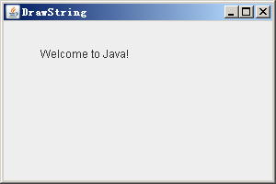
绘制字符串
drawString (String str, int x, int y);
(x,y)

Slide 16
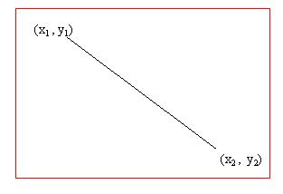
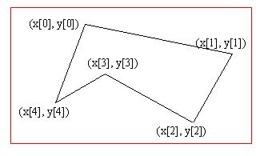
绘制多边型/填充多边形
int[] x = {40, 70, 60, 45, 20};
int[] y = {20, 40, 80, 45, 60};
g.drawPolygon(x, y, x.length);
g.fillPolygon(x, y, x.length);
绘制直线
drawLine(x1, y1, x2, y2);

Slide 17
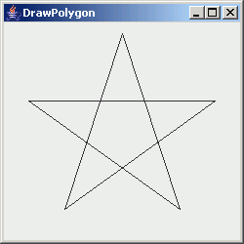
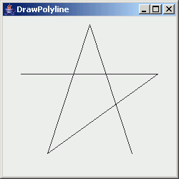
绘制多边形/绘制多点曲线
int[] x = {25, 216, 62, 121, 180};
int[] y = {80, 80, 191, 11, 191};
g.drawPolygon(x, y, x.length);
g.drawPolyline(x, y, x.length);
(x[3],y[3])
(x[3],y[3])
(x[0],y[0])
(x[1],y[1])
(x[0],y[0])
(x[1],y[1])
(x[2],y[2])
(x[4],y[4])
(x[2],y[2])
(x[4],y[4])

Slide 18
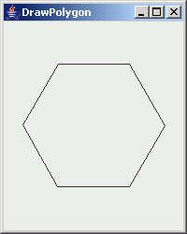
用Polygon对象存储多个点并绘制多边形
Polygon polygon = new Polygon();
polygon.addPoint(25, 80);
polygon.addPoint(216, 80);
polygon.addPoint(62, 191);
polygon.addPoint(121, 11);
polygon.addPoint(180, 191);
g.drawPolygon(polygon);
Example:DrawPolygon.java

Slide 19
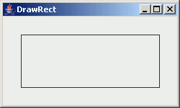
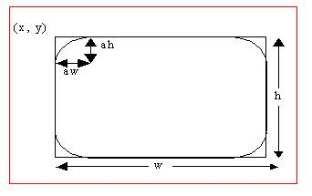
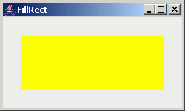
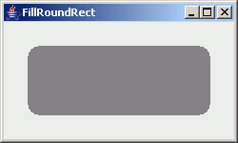
绘制/填充矩形
drawRect(x, y, w, h);
fillRect(x, y, w, h);
绘制/填充圆角矩形
drawRoundRect(x, y, w, h, aw, ah);
fillRoundRect(x, y, w, h, aw, ah);
(x,y)
h
w
(x,y)
(x,y)
ah/2
aw/2
h
h
w
w

Slide 20
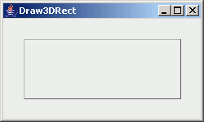
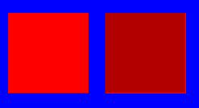
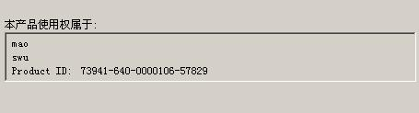
绘制3D矩形
draw3DRect(x, y, w, h, raised);
填充3D矩形
fill3DRect(x, y, w, h, raised);
(x,y)
h
w

Slide 21
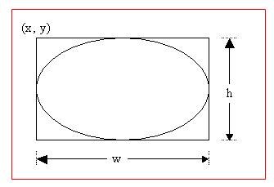
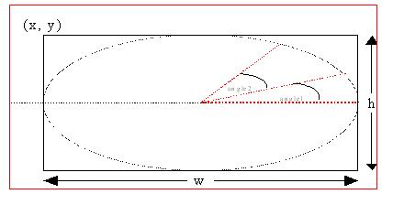
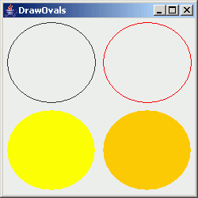
绘制/填充椭圆
drawOval(x, y, w, h);
fillOval(x, y, w, h);
绘制/填充圆弧
drawArc(x, y, w, h, angle1, angle2);
fillArc(x, y, w, h, angle1, angle2);
(x,y)
h
w

Slide 22
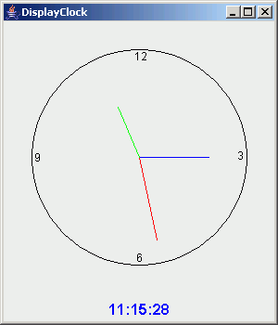
15.10 例 绘制时钟
编写程序,绘制时钟
x = cx + r * sin(θ)
y = cy - r * con(θ)
12
(x,y)
θ
r
9
3
(cx,cy)
6
Example:DisplayClock.java, StillClock.java, MessagePanel.java

Slide 23
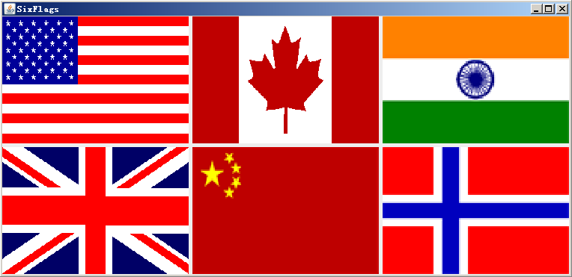
§13.13 Java的图形坐标系
实现一个可缩放显示图像的的组件。
Example: DisplayImage.java, ImageViewer.java, SixFlags.java

Slide 24

import java.awt.*;
import javax.swing.*;
public class DisplayImage extends JFrame{
public DisplayImage(){add (new ImageCanvas());}
public static void main(String []s){
DisplayImage f=new DisplayImage();
f.setTitle("显示图像");
f.setBounds(200,200,300,300);
f.setDefaultCloseOperation(JFrame.EXIT_ON_CLOSE);
f.setVisible(true);
}
}
class ImageCanvas extends JPanel{
ImageIcon ic=new ImageIcon("micky.gif");
Image image=ic.getImage();
public void paintComponent(Graphics g){
//super.paintComponent(g);
if(image!=null)
g.drawImage(image,0,0,getWidth(),getHeight(),this);
}
}
把image画到指定区域，可调整位置和大小

